Slide 1
Recognition and Accreditation of Adult Educators` Competences:
The Model of Weiterbildungsakademie
Österreich – wba
(Austrian Academy of Continuing Education)

Slide 2
Table of Content
What is the Austrian Academy of Continuing Education / wba ?
Founded by… Organisational Milestones & Structure
Professionalisation of “Adult Educators“
Standards: Competence Profiles, Target Groups
Process of Recognition and Accreditation

Slide 3
What is the Austrian Academy of Continuing Education / wba ?
Founded by…
Organisational Milestones
Structure

Slide 4
wba – a Model of Recognition of Adult Educators´ Competences
wba is an initiative that validates and recognises competences of adult educators
Recognises formally, non-formally and informally acquired competences
No educational provider
Awards qualifications for adult educators
Improves professionalisation and quality in work

Slide 5
Reasons for Setting up wba
Estimated 100 000 adult educators in Austria
No Austrian-wide standardised vocational education and qualification
Professionalisation / setting standards
Increasing permeability of the education system → e.g. specific master study programmes
Need to recognise already acquired competences / prior learning

Slide 6
Founded and Carried by
The Cooperative System of the Austrian
Adult Education
Austrian Conference of Adult Education Institutions (KEBÖ)
&
Austrian Federal Institute for Adult Education (bifeb)

Slide 7
Milestones
2004-2006: Preparatory Project
Established in 2007
ESF-project until end of 2013
Since 2014 regularly financed through the Austrian Ministry of Education and student fees
2013: Curricula defined by learning outcomes
2013: Validation Prize of European observatory of validation of nonformal & informal learning

Slide 8
The wba´s Working – Structure
Steering and leading pedagogical issues, evaluation, marketing,…
Steering Committee
Deals with the applications of the students, recognition of evidences
wba-
office
Counselling, portfolio work
Accredi-tation Council

Slide 9
2. Professionalisation of “Adult Educators“
Standards: Target Groups,
Competence Profiles

Slide 10
Target Groups – „Adult Educators“
Educational Managers | Teachers / Trainers
Counsellors | Librarians

Slide 11
Why do Adult Educators apply for certification?
Recognition of their professional experience and of already acquired competences
Occupational degree as adult educator
Possible requirement by employers, e.g. in the field of basic education (literacy)

Slide 12
3. Process of Recognition
and Accreditation

Slide 13
Process of Recognition (wba-Certificate)
Portfolio work: identifying competences
Comparing competences with wba-curricula
Status quo evaluation
Guidance but no courses provided
Handing in of further proofs
Certification workshop
Degree
Average duration: 8 months

Slide 14
Required Competences: „wba-Certificate”
Educational Theory
Practical Experience
Certification Workshop
Teaching Skills
Educational Management Skills
Counselling Skills
Library and Information Management Skills
Social Skills
Personal Skills
14
Notes:
14

Slide 15
Types of Proofs handed in
Formally aquired competences: degrees, school reports,…
Non-formally aquired: certificates of seminars, courses, ...
Informally aquired: written recommendations, papers, theses, seminar concepts, brochures,…..
Austrian Academy of Continuing Education Petra Steiner
15
Notes:
15

Slide 16
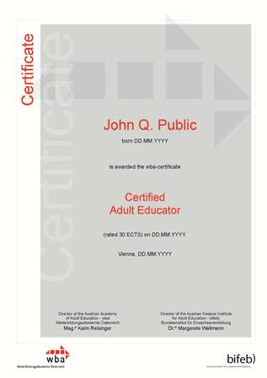
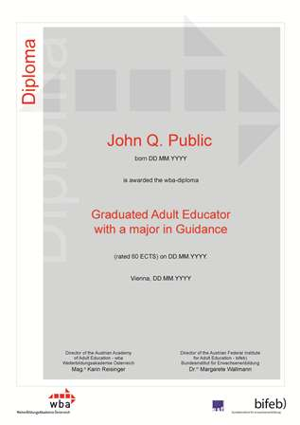
2 Different Qualifications
wba-Certificate
Basic Degree for all Adult Educators
wba-Diploma
Specific Degree for
Teachers / Trainers
Counsellors
Educational Managers
Librarians / Informational Managers
Notes:
16

Slide 17
Facts up to May 2014 … approximately
1800 Registrations for the certification process
1300 Portfolios evaluated
720 Certificates for Adult Educators
170 Diplomas awarded:
33 Counselling
76 Educational Management
58 Teaching/Training
3 Library/Informational Management

Slide 18
wba-Office
Siebensterngasse 21/2
1070 Vienna
Austria

Slide 19
Thank you for your attention!
www.wba.or.at
Tel: ++43-1-5242000
Funded by the Federal Ministry of Education and Women´s Affairs

